Slide 1
Quickbreads
Flour Mixtures

Slide 2
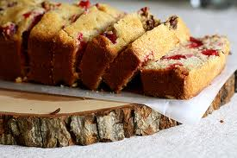
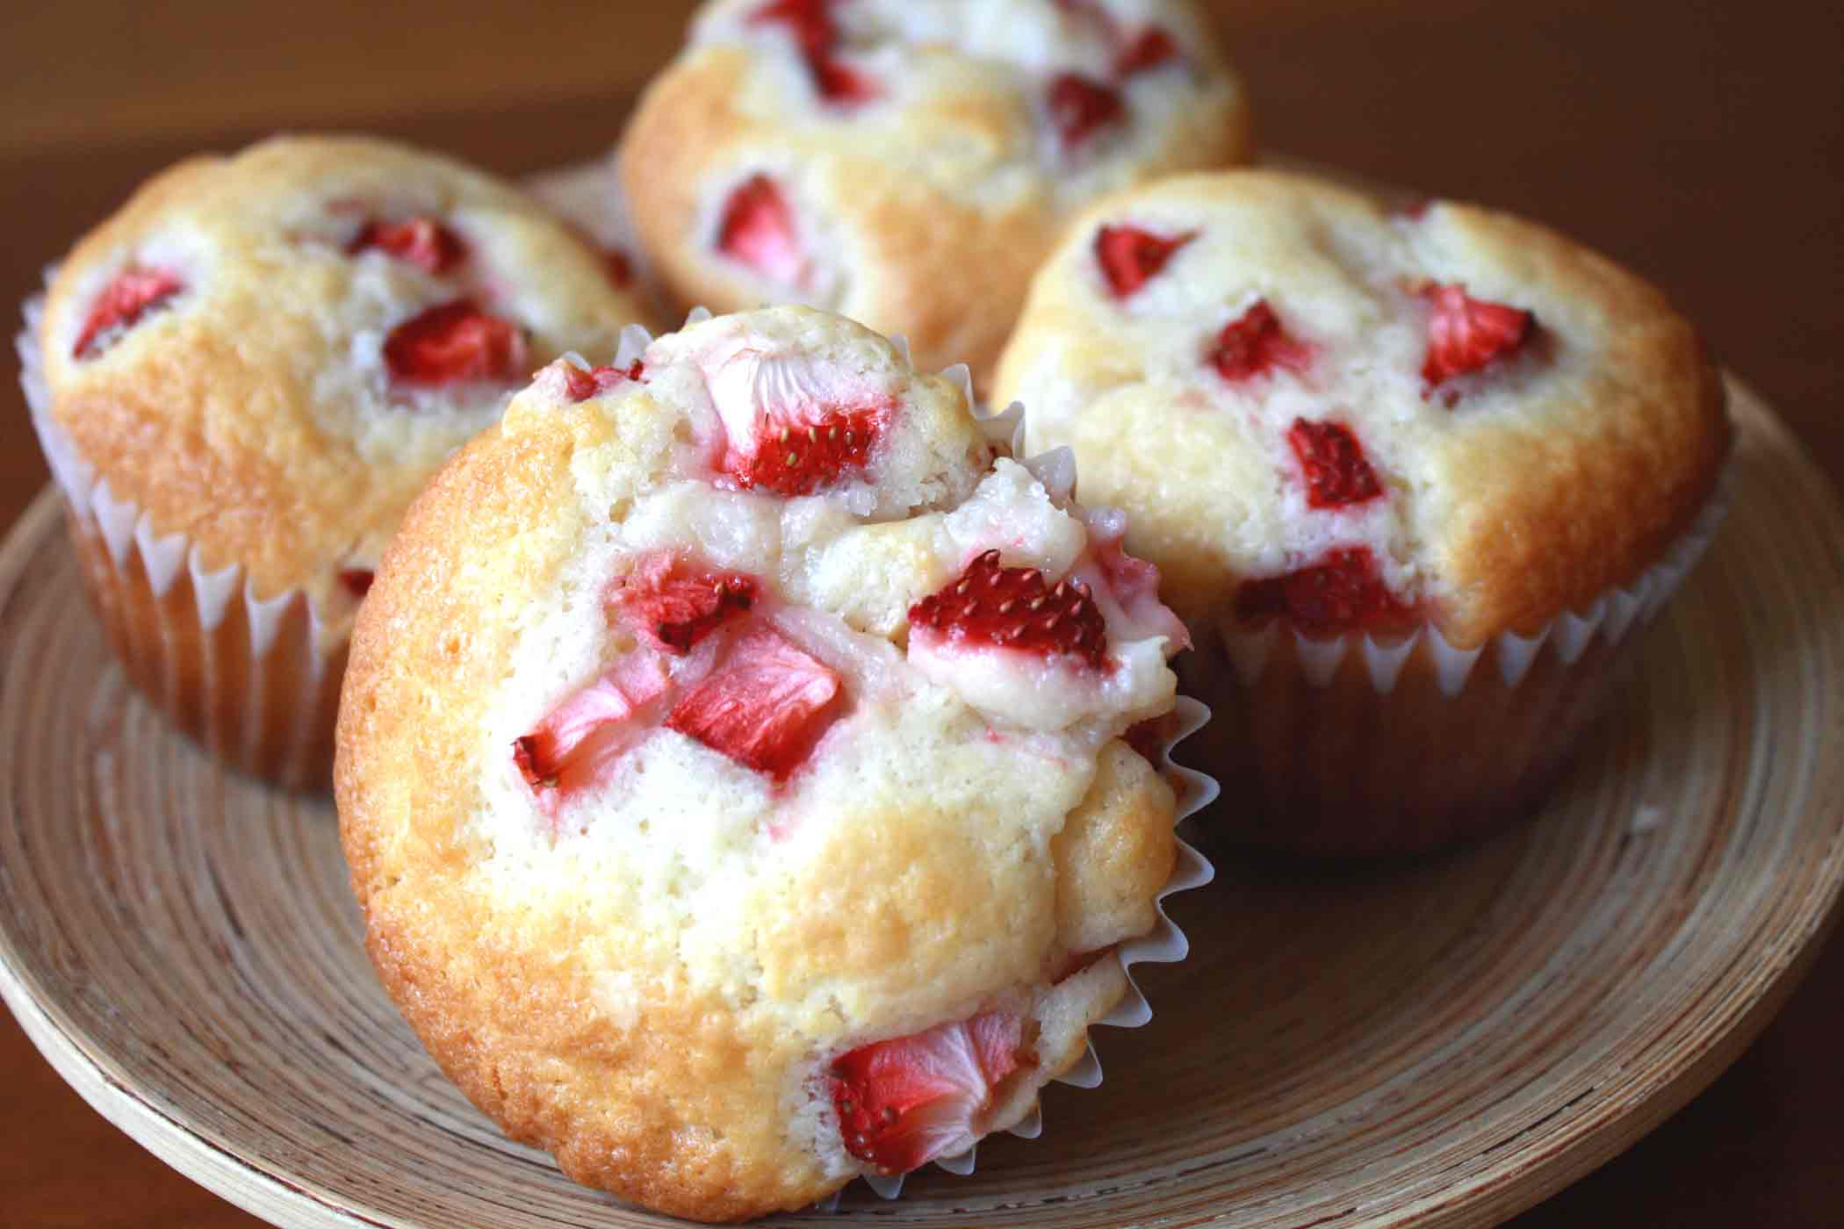
Quickbreads

Slide 3
Quickbreads
Quick to make
Quick to rise
Quick to bake
Quick to clean up

Slide 4
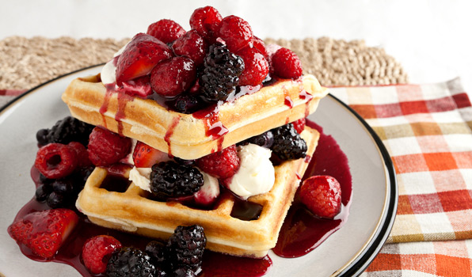
Types of Quickbreads
Pour Batter
Ratio is 1 to 1 wet to dry
Pancakes, crepes, and waffles

Slide 5
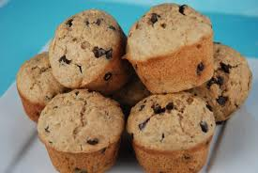
Types of Quickbreads
Drop Batter
Ratio 1 to 2 wet to dry
Muffins, coffeecakes

Slide 6
Types of Quickbreads
Soft Dough
Ratio 1 to 3 wet to dry
Biscuits, pizza

Slide 7
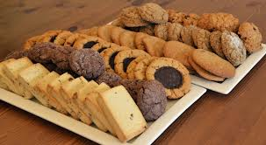
Types of Quickbreads
Stiff Dough
Ratio 1 to 4 wet to dry
Cookies

