Slide 1
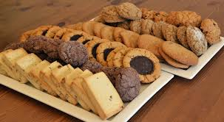
Cookies

Slide 2
Cookies
Cookies are really “little cakes”.
Cookie recipes call for little or no liquid so the unbaked mixture is thicker than a cake batter.
The main nutrient in cookies is carbohydrates. The food value can be improved by the addition of nutritious ingredients.

Slide 3
Cookies
List your top five favourite homemade cookies.
List your favourite store bought cookies.
Is there a cookie that you do not like? Homemade or bought.

Slide 4
Cookies
Cookies are split into 6 different categories.
Drop
Rolled
Refrigerator
Molded
Pressed
Bar
Try to think of one example for each category.

Slide 5
Drop Cookies
Made from a soft dough which is pushed from a spoon onto a baking sheet in the size desired.
Less evenly shaped than rolled cookies.
What are some examples of drop cookies?

Slide 6
Rolled Cookies
Cut from a thin sheet of stiff dough, with cutters of various shapes.
Evenly shaped and, and usually very thin.
What are some examples of rolled cookies?

Slide 7
Refrigerator Cookies
Cut from a roll of dough which has been chilled until very stiff.
Less evenly shaped than the rolled cookies.
Can be either thick or thin.
What are some examples of refrigerator cookies?

Slide 8
Molded Cookies
Made from small portions of a stiff dough molded or shaped with the hands.
May be left in the shape of balls or slightly flattened.
What are some examples of molded cookies?

Slide 9
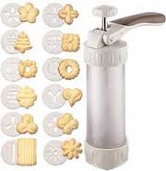
Pressed Cookies
Made from a stiff rich dough which is forced through a cookie press to give various shapes.
What are some examples of
pressed cookies?

Slide 10
Bar Cookies
Baked in a shallow pan
The dough is cooked and then cut into oblong or square shapes as desired.
What are some examples of bar cookies?

Slide 11
Cookie Dough
There are two kinds of cookie dough:
Soft Dough – bar and drop cookies
Stiff Dough – refrigerator, rolled, pressed and molded
Ingredients:
Cookie doughs require the same basic ingredients used in cake batters but the proportions are different. Cookies need less liquid and leavening and may need more fat.

Slide 12
Cookie Qualities
Tenderness – shortening, fat and sugar
Rich flavour – shortening, fat and sugar
Structure – flour and eggs

